Slide 1
Evaluation of Stochastic Computing for Efficient Deep Neural Network Inference
Master Thesis - Javier Ferrer Ortega

Slide 2
AGENDA
Theoretical Background
SC DNN Framework Implementation & GPU Acceleration
Results
Conclusions

Slide 3
Theoretical Background

Slide 4
Stochastic Computing?
Binary Computation
Alternative to traditional binary computation.
Treats computed numbers as probabilities 𝑝𝑋, refered as stochastic numbers -> represented by bitstreams of random 1s and 0s.
Neither the length nor the structure of a bitstream needs to be fixed, so:
Decimal number
x = 0.25
0.01₂​
to binary
Arithmetic operations:
Addition:
Full adder
Ripple-carry adder
Carry-lookahead adder
Multiplication:
Booth's algorithm multiplier
stochastic number
𝑝𝑋 = 0.25
[1,0,0,0]
[0,1,0,0]
[0,1,0,0,0,1,0,0]
Arithmetic operations are realized by means of single logic gates like AND, OR…

Slide 5
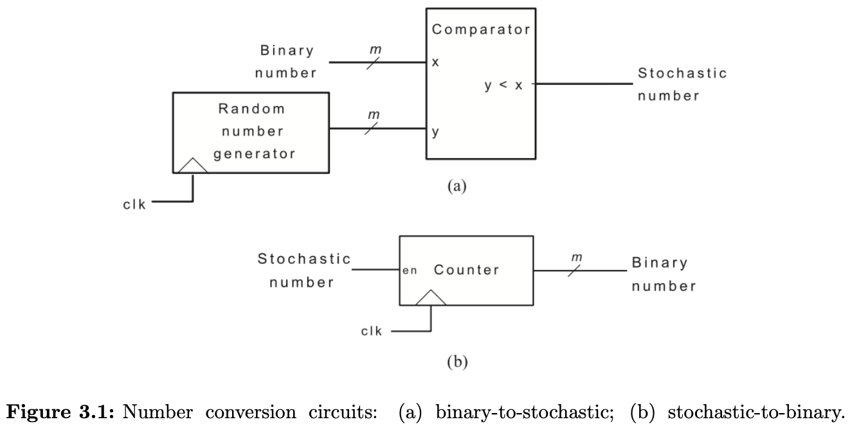
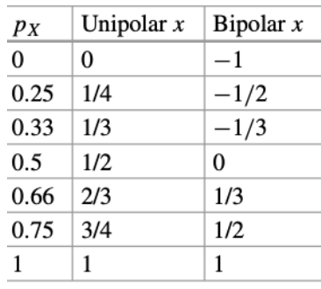
Stochastic number generation & convertion to binary:
If bipolar: x = 0.5 (1 + 0.25) = 0.625 -> [1, 1, 0, 1] -> px = ¾
0.25
Stochastic
Bitstream
[0,0,0,1]
range [0 , 1] [-1 , 1]
[0.34, 0.56, 0.78, 0.11]
If bipolar:
bin. no. = (2*px - 1)
Stochastic
Bitstream
[0,0,0,1]
px = N1 / N = 1/ 4
N1: total no. of ones
N: bitstream length
A comparison of stochastic numerical formats
Table 1. Taken from [2].
Binary to stochastic. (b) Stochastic to binary.
Taken from [1].

Slide 6
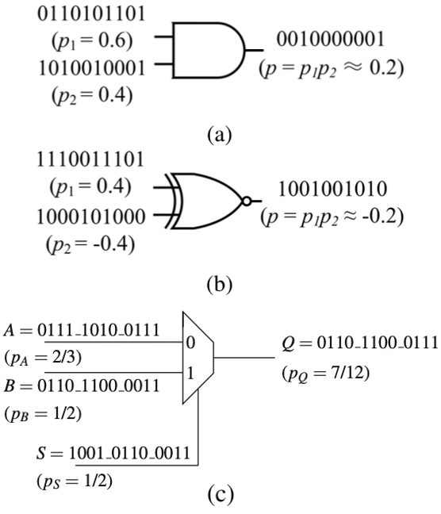
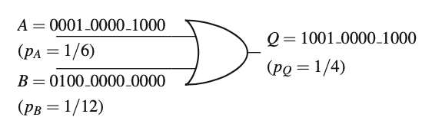
Stochastic Computing Operations:
p_{A} + p_{B} = p_{Q}
p_{A} + p_{B} = p_{Q}
SC multiplier: AND gate – Unipolar bitstreams
SC multiplier: XNOR gate – Bipolar bitstreams
(d)
(c) SC adder: MUX
(d) SC adder: OR gate

Slide 7
Benefits
SC allows the operation of arithmetic functions with very few logic gates in hardware designs:
Addition: MUX / OR gate
Multiplication: AND / XNOR gate
Small component size -> low power applications
High error tolerance -> resilient to bit flippings (e.g. found in bit-flipping attacks [3] or radiation-induced errors [4]).

Slide 8
Benefits vs Drawbacks
SC allows the operation of arithmetic functions with very few logic gates in hardware designs:
Addition: MUX / OR gate
Multiplication: AND / XNOR gate
Small component size -> low power applications
High error tolerance -> resilient to bit flippings (e.g. found in bit-flipping attacks [3] or radiation-induced errors [4]).
Longer computation times that lead to->
higher energy consumption costs (energy = power × time)
Low precision applications (e.g. image processing, DNNs computation) ->
Only 4 stochastic bits needed to represent 0.25 -> (1,0,0,0) but to represent 0.5625 accurately, the stochastic bitstream must be longer -> (0,1,0,1,0,1,0,1,0,1,0,1,0,1,1,1): 16 bits.

Slide 9

SC DNN Framework
Why? - Motivation: To compare different SC DCNNs and evaluate the requirements needed to achieve effective inference using Stochastic Computing.
How? – Framework Architecture:
Stochastic Tensor Generator
SC 2D convolution
SC Fully Connected Layer
However…

Slide 10
SC DNN Framework: SC 2D convolution & SC Fully connected layers
A Stochastic Computing extension to PyTorch’s DNN functions, in CPU:

Slide 11
GPU Acceleration

Slide 12
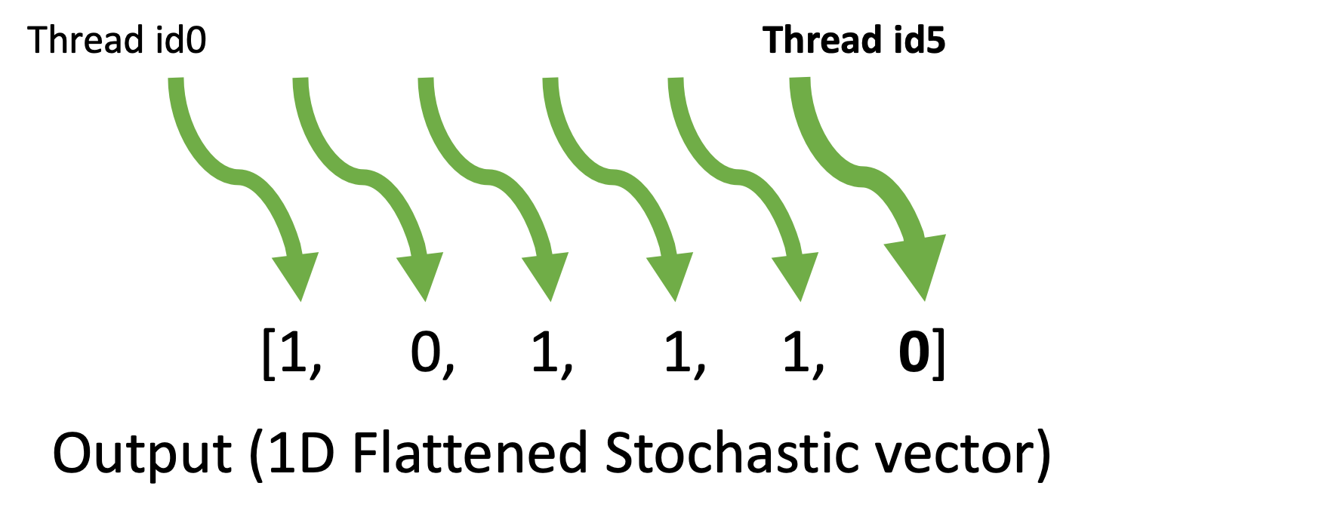
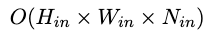
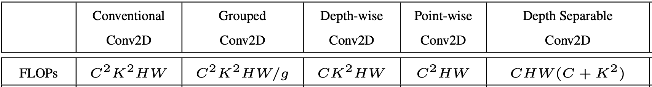
Objective: Reduce SC Conv2d and SC FC Layer functions’ CPU time complexities “O(n)” with GPUs’ multi-threaded data-parallelism
Fully Parallelized
Stochastic Tensor Generator CPU O(n) time complexity:
FLOPs:
Stochastic Bitstream
Table 2. A comparison of 2D convolutions computational complexity. Taken from [3].

Slide 13
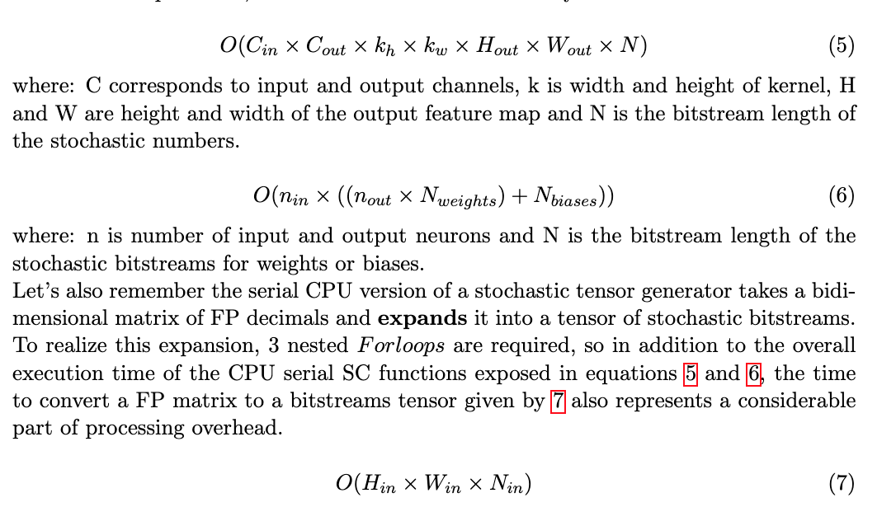
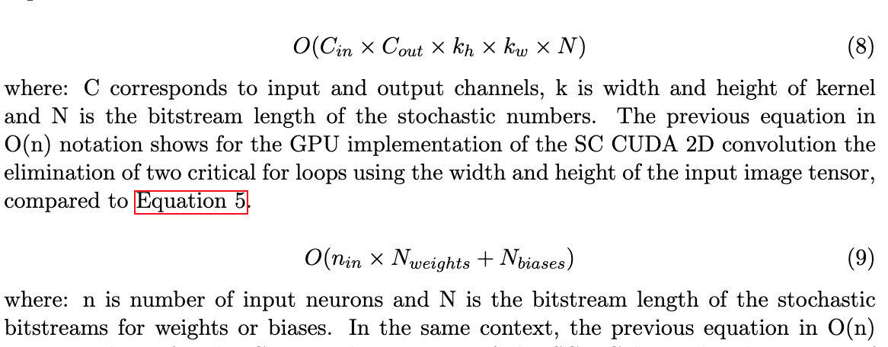
Objective: Reduce SC Conv2d and SC FC Layer functions’ CPU time complexities “O(n)” with GPUs’ multi-threaded data-parallelism
Fully Parallelized
Stochastic Tensor Generator CPU O(n) time complexity:
FLOPs:
Stochastic Bitstream
SC 2D Convolution CPU O(n) time complexity:
SC Fully Connected Layer CPU O(n) time complexity:
GPU O(n):
GPU O(n):

Slide 14
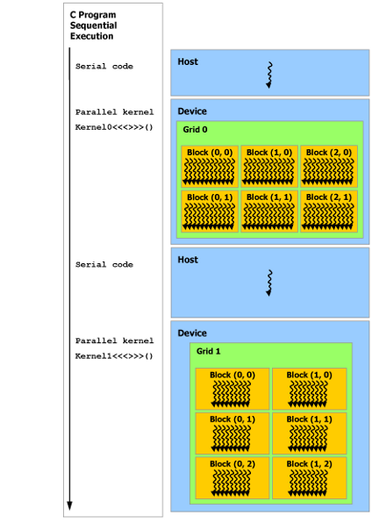
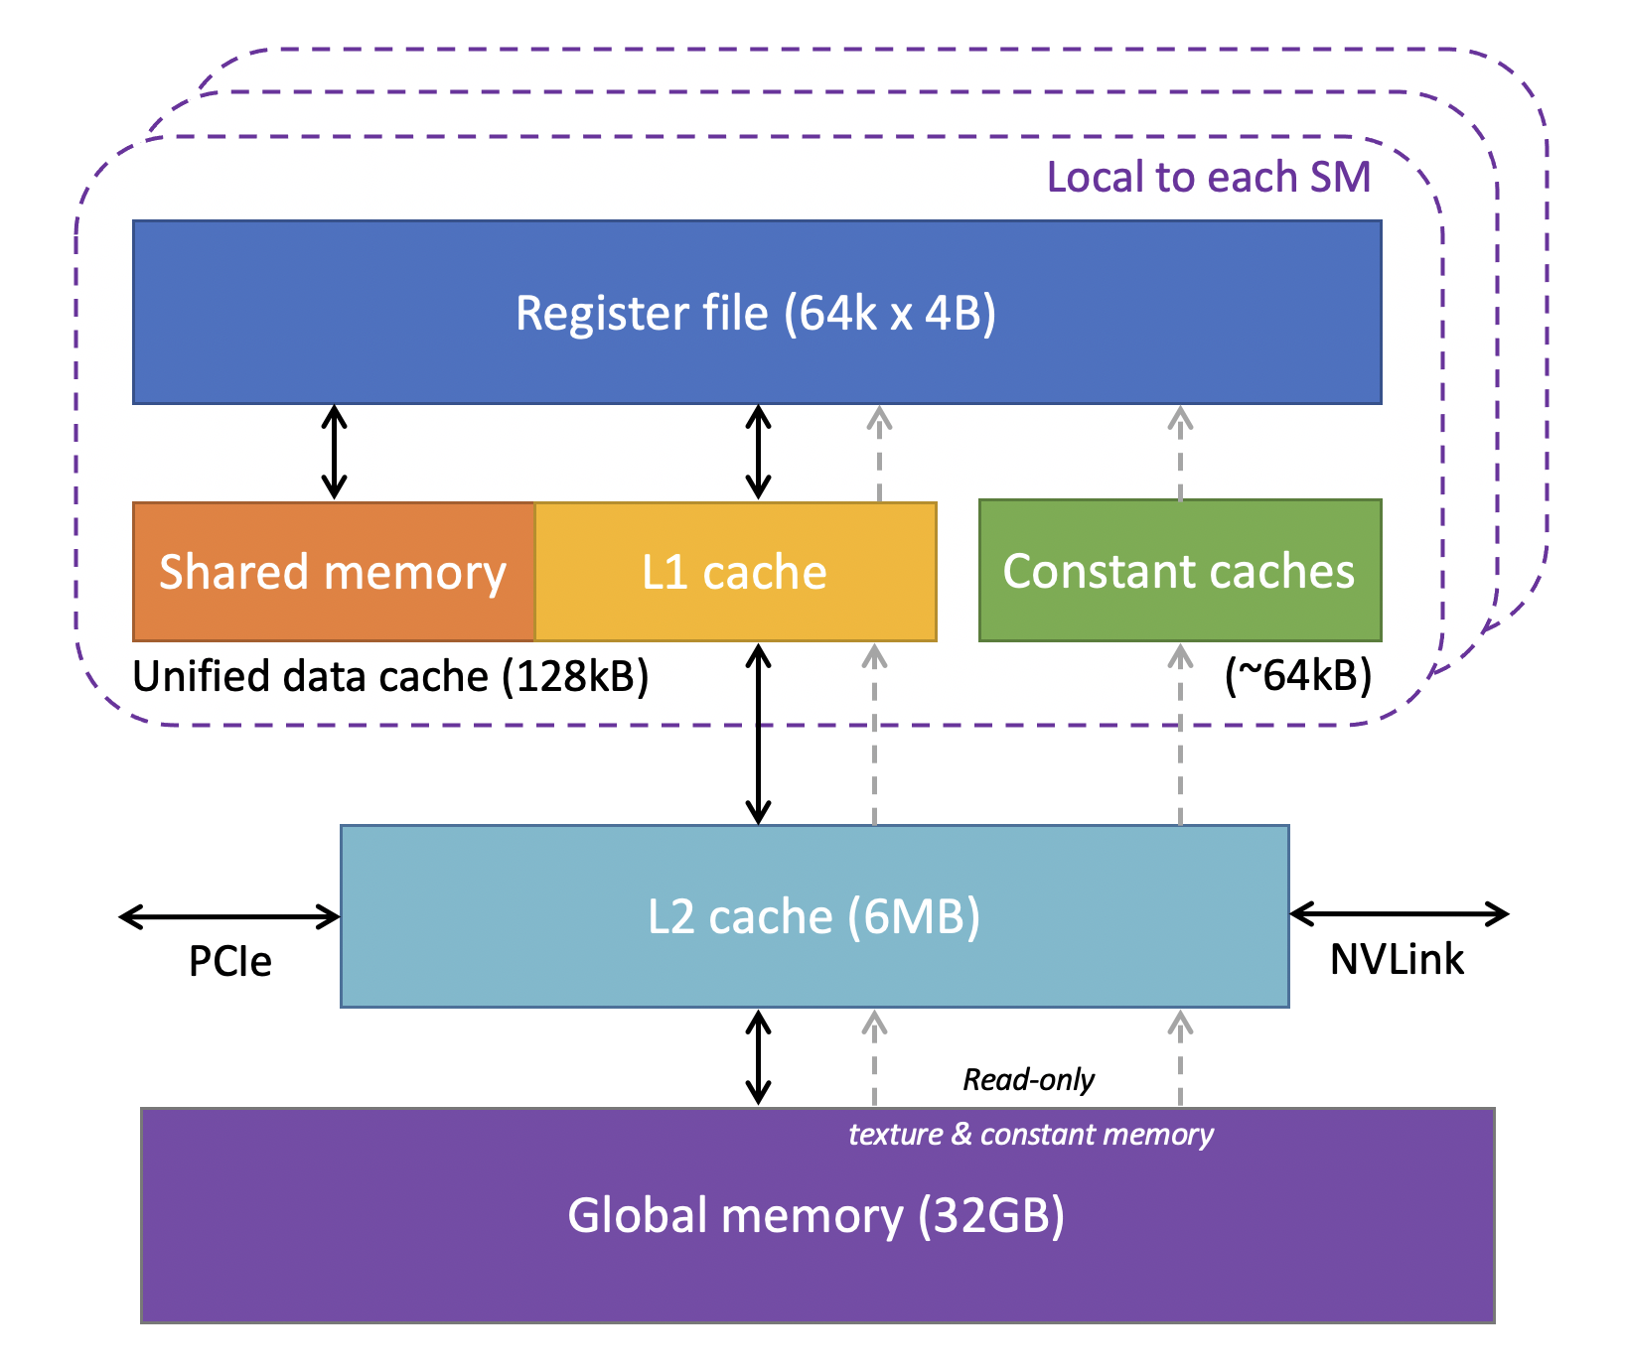
CUDA kernel execution model
Memory Hierarchy
HARDWARE
Taken from [4].
Taken from [5].

Slide 15
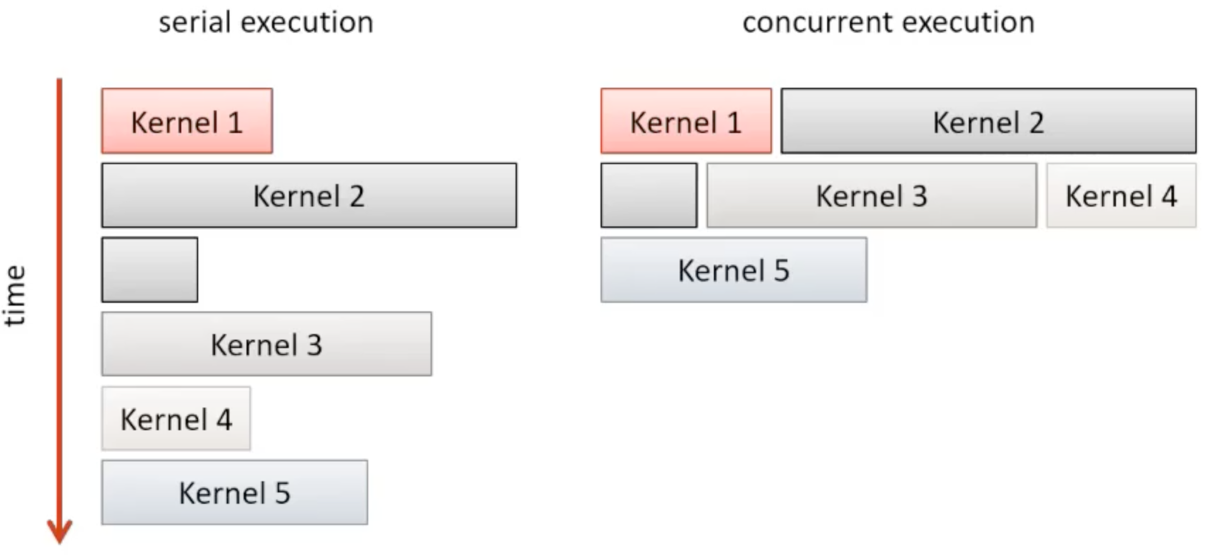
CUDA STREAMS
Taken from [6].

Slide 16
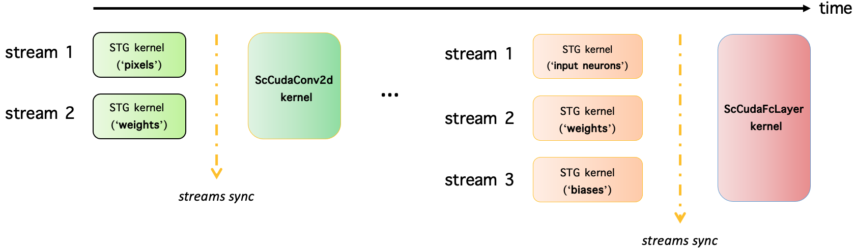

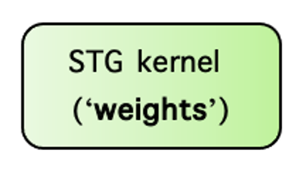
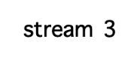
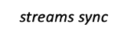
SC CNN CUDA model
CUDA STREAMS
Taken from [6].
(‘biases’)

Slide 17
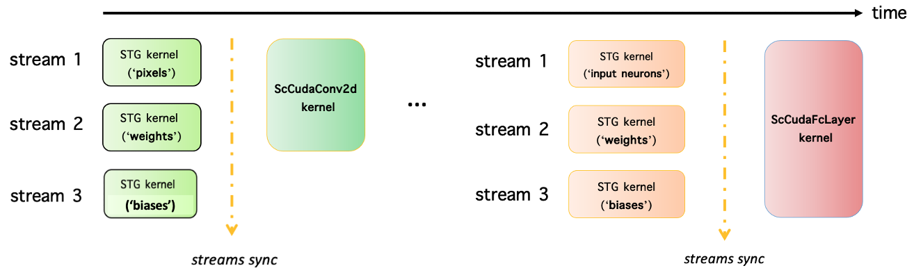
Stochastic Tensor Generator kernel - parallel approach

Slide 18
SC 2D Convolution kernel - parallel approach
5 x 5
3 x 3
3 x 3
A
B
C
0,1,0,1…
1,0,1,0…
0,1,0..
0,1,0..
a
b
c
D
Accum_
E
F
0,1,0,1…
1,1,1,1…
Thread id_0
0,1,1..
0,0,1..
0,0,1..
AND/XNOR
d
e
f
Output [0] [0]
G
H
I
0,0,0,0…
1,1,1,1…
1,1,1..
0,0,0..
1,0,1..
g
h
i
0,0,0,0..
1,1,1,1…
0,1,0,1…
0,1,0,0…
0,0,0,1…
2D Convolution
Filter
2D Convolution
Output
0,0,0,0…
0,0,1,0…
1,0,1,1…
0,1,0,1…
0,0,0,1…
2D Image

Slide 19
SC Fully Connected Layer kernel - parallel approach
Input Neurons
A
AND/XNOR
1,1,1..
weights[0][0]
Accum_
1,0,1..
B
Thread id_0
AND/XNOR
weights[0][1]
Bias_1
1,1,0..
Out₁
1,1,0..
Output [0]
1,1,1..
Accum_
Accum_
C
weights[0][2]
0,1,1..
AND/XNOR
Out₂
1,1,0..
Accum_
weights[0][3]
D
0,1,0..
0,1,0..
Out₃
AND/XNOR
Accum_
weights[0][4]
E
0,1,1..
Output Neurons
1,1,1..
AND/XNOR

Slide 20
Results

Slide 21
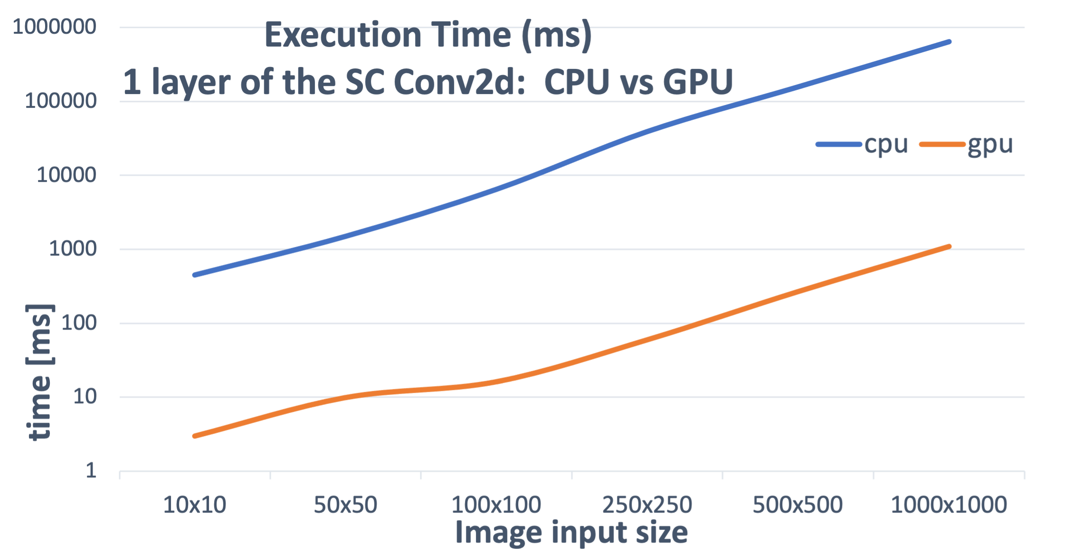
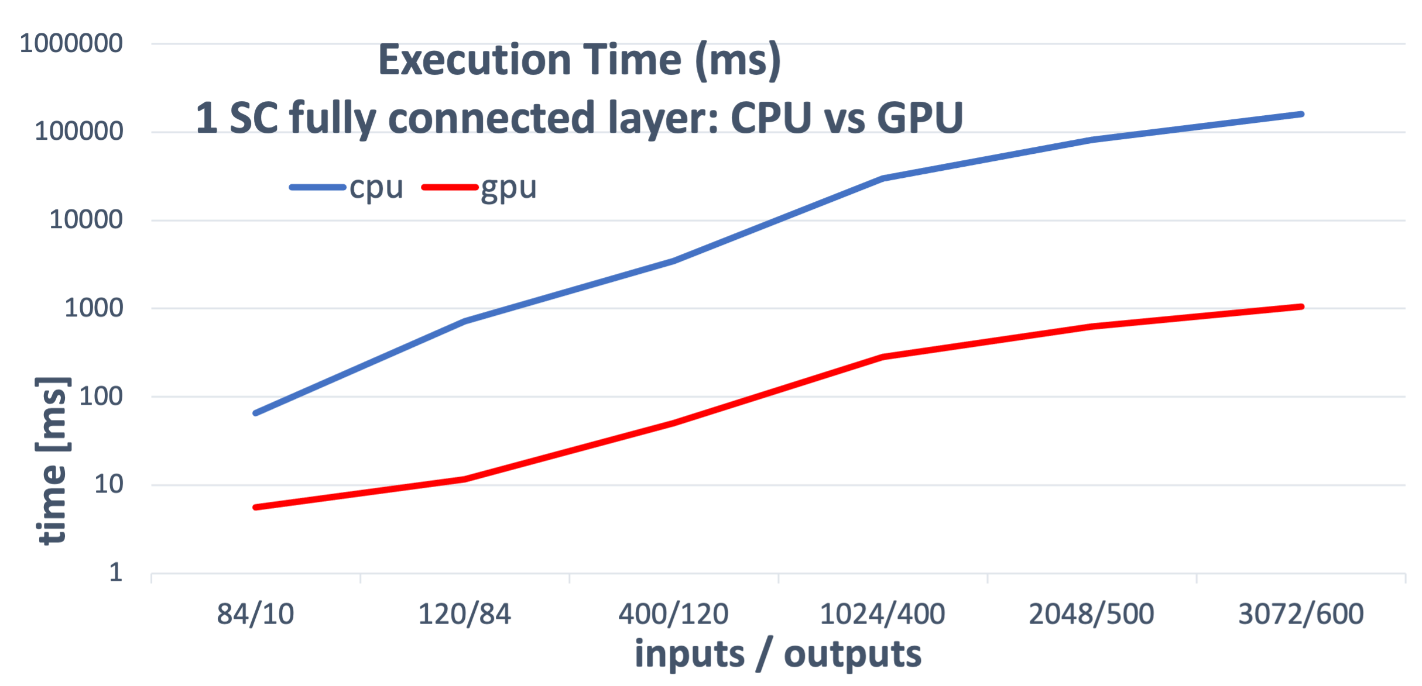
End-to-end execution time [ms] of 1 single layer of a SC 2D Convolution & 1 SC Fully Connected Layer: CPU vs GPU
Gain = x500 (≈2.5 orders of magnitude)
Gain = x150 (≈2 orders of magnitude)
*Used device: NVIDIA V100

Slide 22
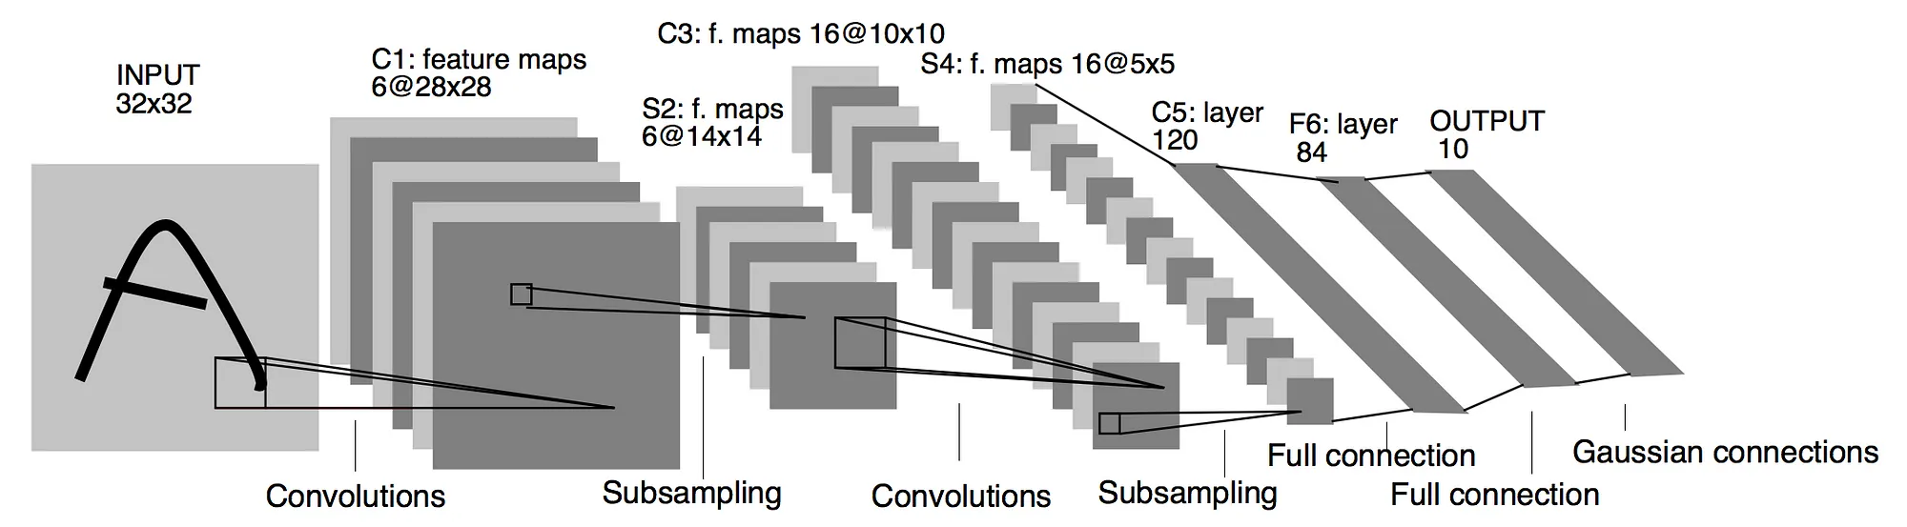
Percentage % of correctly inferred images with SC LeNet-5 per bitstream length (1000 images in total from fashionMNIST dataset)
LeNet-5 architecture: 2 convs, 3 fcls
Taken from [7].
*Used device: NVIDIA V100

Slide 23
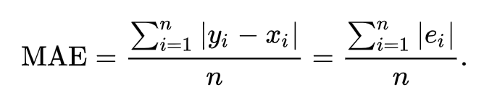
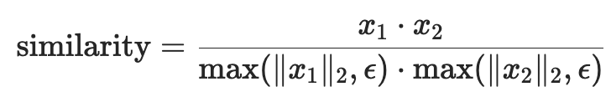
Mean Absolute Error per layer in SC LeNet-5 (average MAE after 100 inferred images of the Sneaker class)
Cosine Similarity per layer in SC LeNet-5
(average similarity after 100 inferred images of the Sneaker class)

Slide 24
Execution time per layer in SC LeNet-5
SC LeNet-5 throughput in frames per minute
*Used device: NVIDIA V100

Slide 25
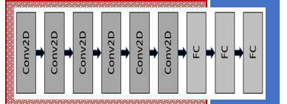
Percentage % of correctly inferred images with SC VGG9 per bitstream length (300 images in total from CIFAR-10 dataset)
VGG9 architecture: 6 convs, 3 fcls
Taken from [8].
*Used device: NVIDIA A100

Slide 26
*Used device: NVIDIA A100

Slide 27
*bitstream length = 512
*bitstream length = 512
*Used device: NVIDIA A100

Slide 28
CONCLUSIONS
Unipolar functions are more precise than bipolars because zeros are actually zeros and not approximations.
In addition, shorter stochastic unipolar bitstreams are able to represent probabilities with more decimals, unlike bipolar numbers.
Finally, unipolar functions can compute more FLOPs in the GPU implementation because it is possible to skip multiplications by 0 (accumulator does not need to be increased).
Extra observation: 16 bit LFSR be the fastest RNG but also the less precise compared to other 3 RNGs, whereas XorShift* was the RNG with less MAE and highest % of correctly inferred images.

Slide 29
REFERENCES
A. Alaghi and J. P. Hayes. Survey of stochastic computing. ACM Trans. Embed. Comput. Syst., 12, May 2013.
Vincent C. Gaudet Warren J. Gross. Stochastic Computing: Techniques and Applications. Springer Nature Switzerland AG, 1. edition, 2019.
Wei, T., Tian, Y. and Chen, C.W., 2020. Rethinking convolution: towards an optimal efficiency.
NVIDIA Corporation. CUDA C++ Programming Guide. NVIDIA Corporation, 2024.
Jason Sanders, Edward Kandrot, and Jack J. Dongarra. Cuda by example: An introduction to general-purpose GPU programming. Addison-Wesley/Pearson Education, 2015.
Shane Cook. CUDA Programming: A Developer’s Guide to Parallel Computing with GPUs. Morgan Kaufmann Publishers Inc., San Francisco, CA, USA, 1st edition, 2012.
https://medium.com/@pechyonkin/key-deep-learning-architectures-lenet-5-6fc3c59e6f4
Chandran, Pravin & Bhat, Raghavendra & Chakravarthi, Avinash & Chandar, Srikanth. 2021. Weight Divergence Driven Divide-and-Conquer Approach for Optimal Federated Learning from non-IID Data. 10.48550/arXiv.2106.14503.

